Slide 1
Introduction to Databases

Slide 2
Database Definition
A database is a systematic collection of information or data so that it can be easily accessed, managed and updated.
We use a DBMS stands for Database Management System in order to control a database.
There are four types of DBMSs : Hierarchical, Network, Relational and Object-Oriented DBMS. On this presentation we are going to focus on Relational Database Management System (RDBMS).

Slide 3
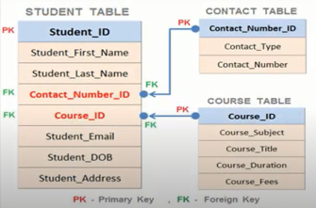
Relational DataBase Management System
RDBMS:
is a software for storing and retrieving users' data by considering appropriate security measures.
RDBMS stores and provides access to data points that are related to one another. Relational databases are based on the relational model, an intuitive, straightforward way of representing data in tables.
Example:

Slide 4
SQL(Structured Query Language)
It is a standard language for accessing and manipulating databases.
What Can SQL do?
Execute queries against a database
Retrieve data from a database
Insert records in a database
Update records in a database
Delete records from a database
Create new databases
create new tables in a database
create stored procedures in a database
create views in a database
set permissions on tables, procedures, and views

Slide 5
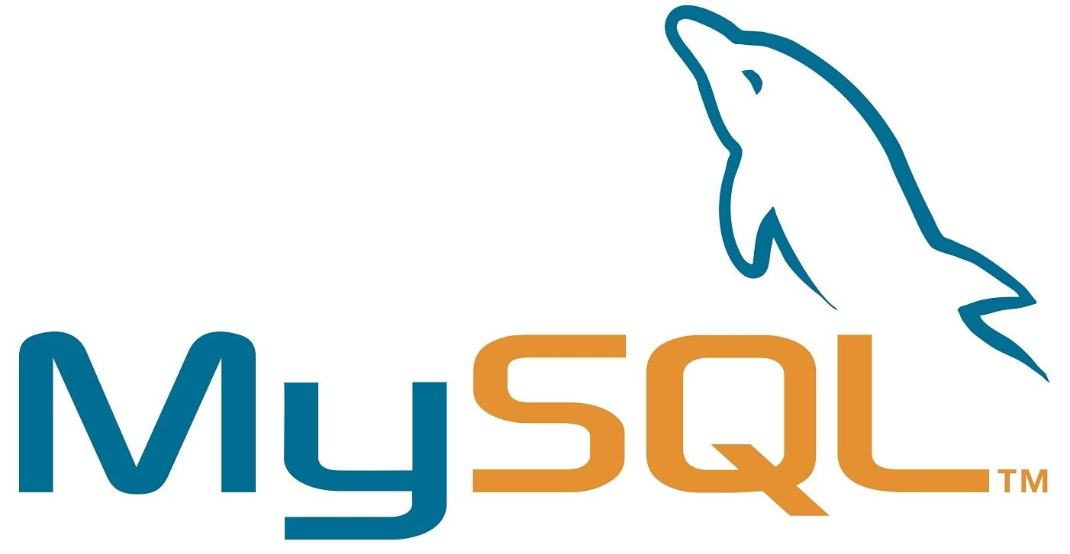
MySQL is a database system used on the web , The data in a MySQL database are stored in tables. A table is a collection of related data, and it consists of columns and rows.
MySQL is a database system that runs on a server
MySQL is ideal for both small and large applications
MySQL is very fast, reliable, and easy to use
MySQL uses standard SQL
MySQL compiles on a number of platforms
MySQL is free to download and use
MySQL is developed, distributed, and supported by Oracle Corporation
MySQL is named after co-founder Monty Widenius's daughter: My

Slide 6
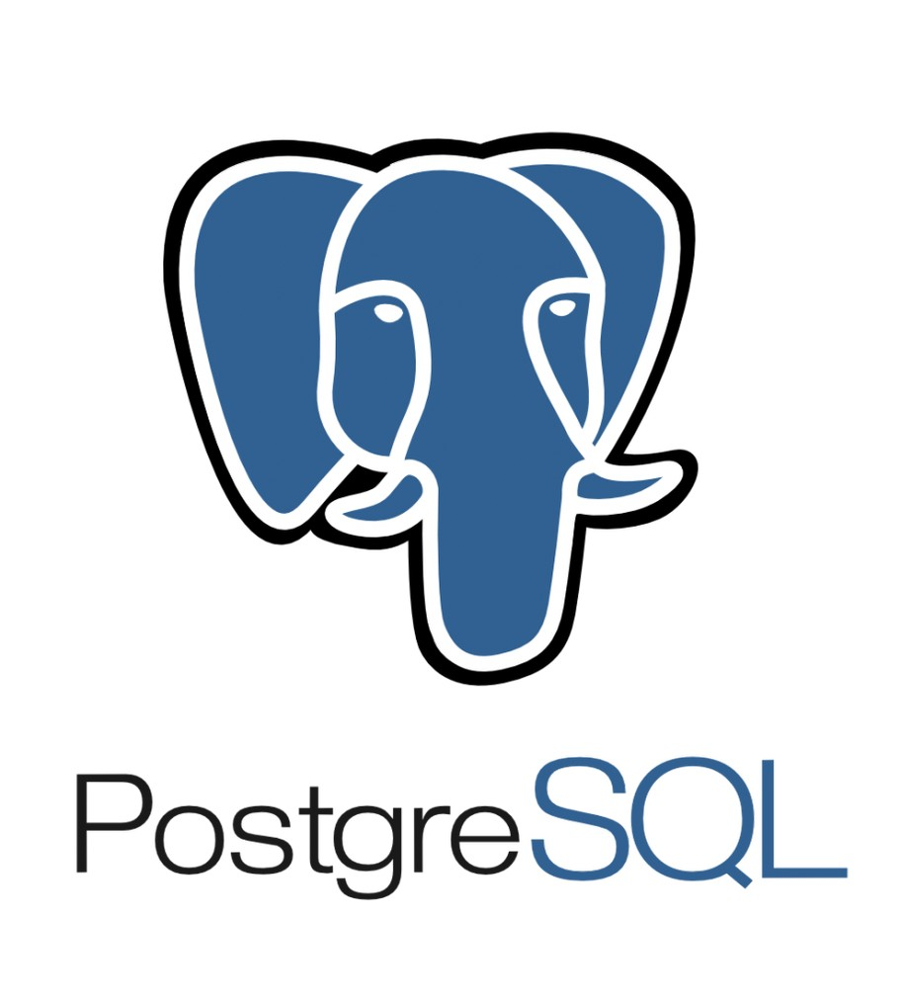
PostgreSQL is a powerful, open source object-relational database system that uses and extends the SQL language combined with many features that safely store and scale the most complicated data workloads.
PostgreSQL is highly extensible. For example, you can define your own data types, build out custom functions, even write code from different programming languages without recompiling your database.
It is a highly stable database management system.
PostgreSQL is used as the primary data store or data warehouse for many web, mobile, geospatial, and analytics applications

Slide 7
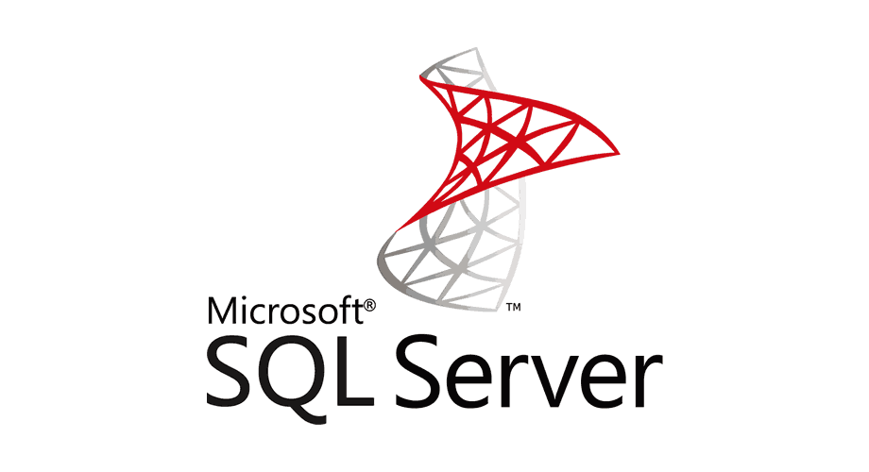
SQL Server is a RDMS developed by Microsoft. As a database server it is a software product with the primary function of storing and retrieving data as requested by other software applications.
Similar to other RDBMS software, SQL Server is built on top of SQL, a standard programming language for interacting with the relational databases.
SQL server is tied to Transact-SQL, or T-SQL, the Microsoft’s implementation of SQL that adds a set of proprietary programming constructs.
SQL Server is ensuring the security of your database.
SQL Server installation and configuration of Microsoft SQL Server are easier

Slide 8
Difference Between the RDBMS
Name | SQL Server | MySQL | PostgreSQL
Description | Microsofts relational DBMS | Widely used open source RDBMS | Widely used open source RDBMS
Primary database model | Relational DBMS | Relational DBMS | Relational DBMS
Secondary database models | Document store Graph DBMS | Document store | Document store
Developer | Microsoft | oracle | PostgreSQL Global Development Group
Data scheme | yes | yes | yes

Slide 9
Difference Between the RDBMS
Name | Microsoft SQL Server | MySQL | PostgreSQL
License | commercial | Open Source | Open Source
Server-side scripts | Transact SQL, .NET languages, R, Python and (with SQL Server 2019) Java | yes | user defined functions
In-memory capabilities | Yes | Yes | No
SELECT ... | Select [col1], [col2] | SELECT col1, col2 | SELECT col1, col2
Using quotation marks | name = ‘John’ only | name = ‘John’ or name = “John” | name = ‘John’ only

Slide 10


